Slide 1
<header>
<nav>
<div>
<grid>
<footer>

Slide 2





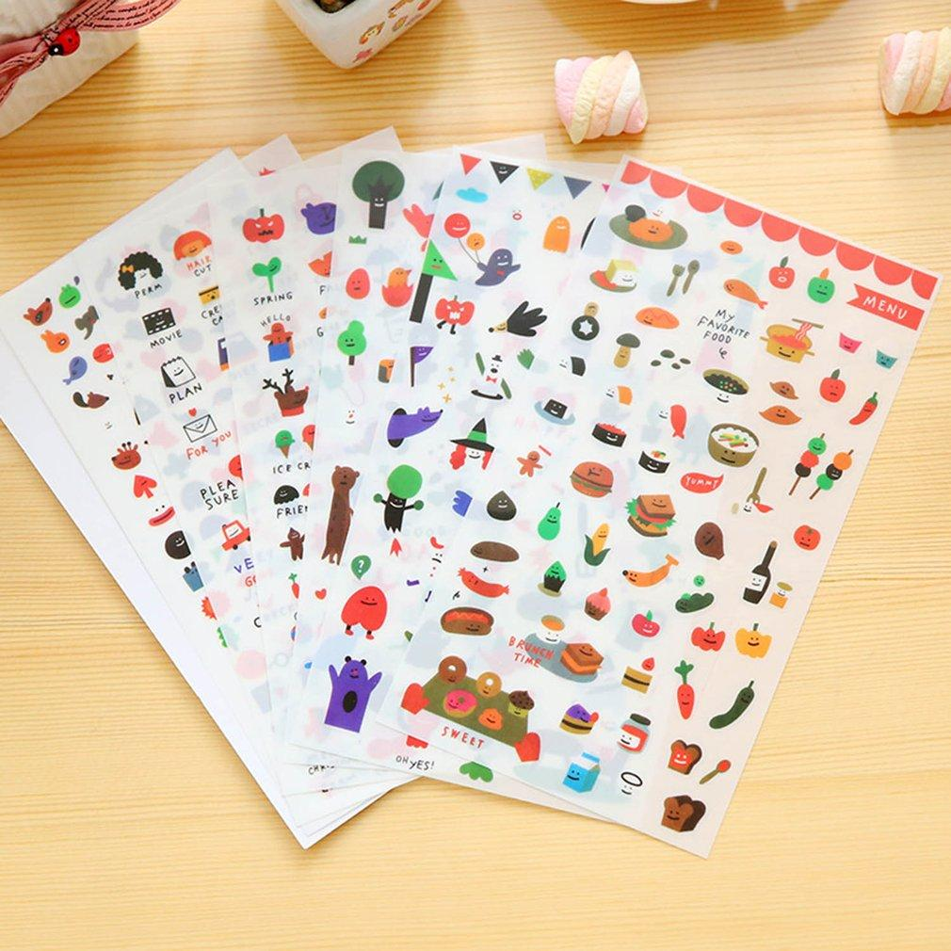
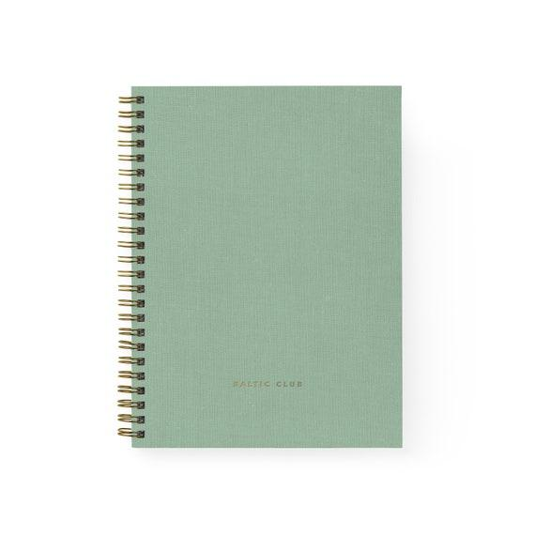

Cozy Stationery
Shop All
Category▾
About us
Payment Shipping & Return Email: cozystationery@mail.com Tel: 345-567-1122

Slide 3
Cozy Stationery
Shop All
Category▾
About us
Shop All (12)
Pattern Sticker $6
Gift Card $5
Colourful Notebook $3
Paint Card $5
Black Ball Pen $4
Notebook $2
Gel Pen $4
Cute Sticker $6
Payment Shipping & Return Email: cozystationery@mail.com Tel: 345-567-1122
About us Payment Shipping & Return Contact us

Slide 4
Cozy Stationery
Shop All
Category▾
About us
Pens
Notebooks
Cards
Stickers
Payment Shipping & Return Email: cozystationery@mail.com Tel: 345-567-1122
About us Payment Shipping & Return Contact us

Slide 5

Cozy Stationery
Shop All
Category▾
About us
About us
Cozy Stationery is a retail store selling all kinds of stationery and trendy products, established in the beginning of 2022. We mainly doing business online.
Our prospect and goal is to import more kinds of masking tape which is originally designed in different countries. We are targeting to share and promote the culture of stationery, handmade and original products in Canada.
Payment Shipping & Return Email: cozystationery@mail.com Tel: 345-567-1122
About us Payment Shipping & Return Contact us

Slide 6



Cozy Stationery
Shop All
Category▾
About us
Payment
1. Apple Pay
2. Credit Card
Payment Shipping & Return Email: cozystationery@mail.com Tel: 345-567-1122
About us Payment Shipping & Return Contact us

Slide 7
Cozy Stationery
Shop All
Category▾
About us
Shipping & Return
Shipping
We provide free standard shipping on orders above $20 CAD to CANADA orders only.
Return
Only when an item is out of stock, delivered incorrectly, or is delayed by more than seven days from its scheduled arrival date and the retailer ships the item without notifying the client are returns and refunds permitted. The only option available is replacement if the product is in the right style but has a defect in its quality. Any issues with the quality of the items brought on by people after receiving them will not be accepted for returns or refunds, and it is not eligible to returns and refund. Within 30 days of the order's shipment date, all returned items must be in brand-new condition. If not, the retailer reserves the right to refuse the return.
Payment Shipping & Return Email: cozystationery@mail.com Tel: 345-567-1122
About us Payment Shipping & Return Contact us

